Slide 1


Collaborative Filtering with ESVD
DA/ML 김민서
2016 ppt by ⓒ 유비

Slide 2
Recommender System
Matrix Factorization
ESVD
Evaluation
MESVD
Extensions of ESVD
INDEX
2016 ppt by ⓒ 유비

Slide 3
I. Recommender System
Collaborative Filtering
Content-Based Filtering
Knowledge-Based Filtering
Hybrid

Slide 4
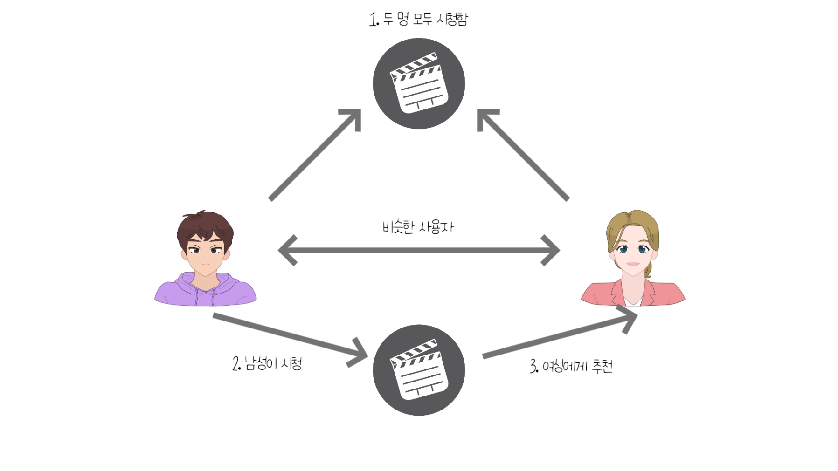
I. Collaborative Filtering
Predict items based on the past knowledge about preferences of users for items

Slide 5
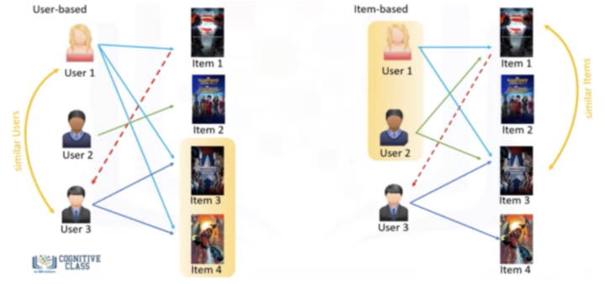
I. Collaborative Filtering: memory-based
Focus on relationships between users (user-based) or items (item-based)

Slide 6
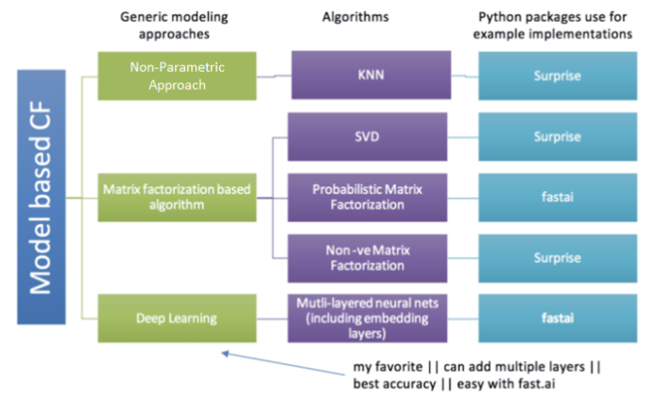
I. Collaborative Filtering: model-based
Based on prediction models that have been trained using the rating matrix

Slide 7
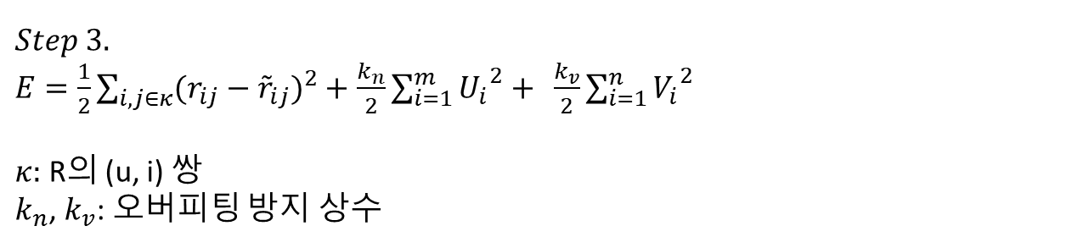
II. Matrix Factorization: Regularized SVD
$$Step 1.$$
Rating matrix $R∈ℝ^{m×n}$을 $U∈ℝ^{k×m}, V∈ℝ^{k×n}$으로 분해한다.
$$Step 2.$$
${\tilde{r}}_{ij}={U_{i}}^{T}V_{j}를$ 계산한다.($\tilde{R}=U^{T}V$)
$$Step 3.$$
$E=\frac{1}{2}\sum_{i, j∈κ}{{(r_{ij}−{\tilde{r}}_{ij})}^{2}}+$ $\frac{k_{n}}{2}\sum_{i=1}^{m}{{U_{i}}^{2}}+ \frac{k_{v}}{2}\sum_{i=1}^{n}{{V_{i}}^{2}}$
$κ:$ R의 (u, i) 쌍
$k_{n}$, $k_{v}$: 오버피팅 방지 상수

Slide 8

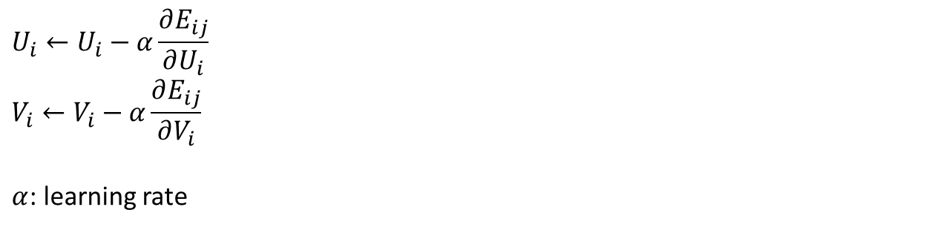
II. Matrix Factorization: Regularized SVD
$$Stochastic Gradient Descent\left(SGD\right)$$
$κ$번 반복
$$U_{i}←U_{i}−α\frac{∂E_{ij}}{∂U_{i}}$$
$$V_{i}←V_{i}−α\frac{∂E_{ij}}{∂V_{i}}$$
$α$: learning rate
Modify U, V in the opposite direction of the gradient

Slide 9
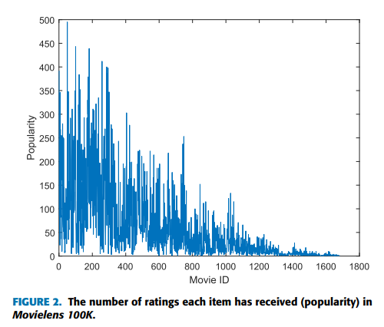
III. Enhanced SVD Model
1) Seeking high density through popular items
Item-oriented approach

Slide 10
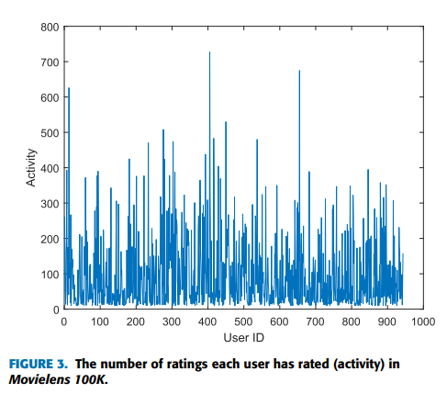
III. Enhanced SVD Model
2) Seeking high density through active users
User-oriented approach

Slide 11
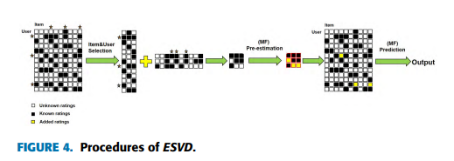
III. Enhanced SVD Model
3) Proposed ESVD density-oriented approach
matrix가 dense할수록 MF 모델의 성능이 향상된다는 점에 근거함
User-oriented + item-oriented
ESVD

Slide 12
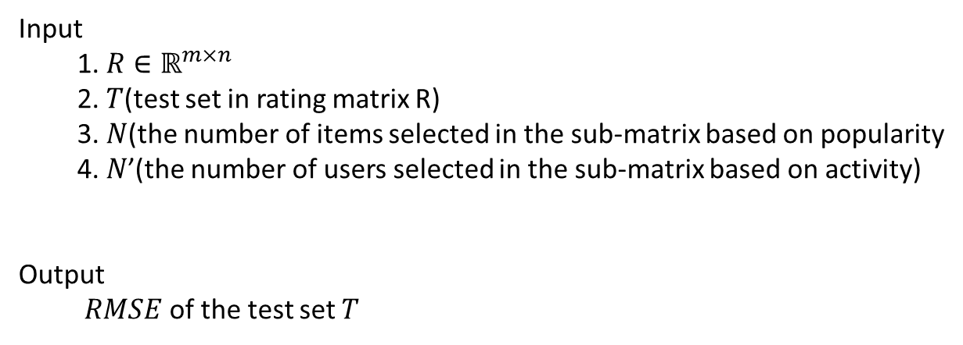
III. Enhanced SVD Model
3) Proposed ESVD density-oriented approach
Input
1. $R∈ℝ^{m×n}$
2. $T$(test set in rating matrix R)
3. $N$(the number of items selected in the sub-matrix based on popularity
4. $N$’(the number of users selected in the sub-matrix based on activity)
Output
$RMSE$ of the test set $T$
ESVD

Slide 13

III. Enhanced SVD Model
3) Proposed ESVD density-oriented approach
Step 1: 아이템, 유저 리스트를 내림차순으로 정렬한다.
Criterion: popularity, activity
Step 2: Top N개의 아이템을 선택하여 $M_{1}$을 만든다.
$$M_{1}=[Q_{j\left(1\right)},Q_{j\left(2\right)},…,Q_{j\left(N\right)}](N<m)$$
Step 3: Top N’명의 유저 선택하여 $M_{2}$을 만든다.
$$M_{2}=[P_{i\left(1\right)},P_{i\left(2\right)},…,P_{i\left(N^{′}\right)}](N′<n)$$
Step 4: $M_{3}=M_{1}∩$ $M_{2}$
ESVD

Slide 14
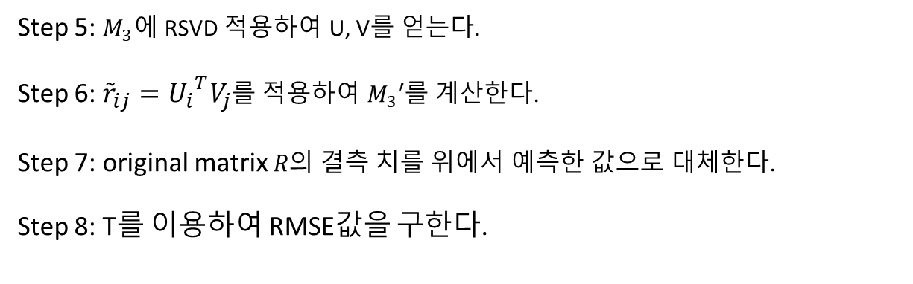
III. Enhanced SVD Model
3) Proposed ESVD density-oriented approach
Step 5: $M_{3}에$ RSVD 적용하여 U, V를 얻는다.
Step 6: ${\tilde{r}}_{ij}={U_{i}}^{T}V_{j}$를 적용하여 $M_{3}′$를 계산한다.
Step 7: original matrix $R의$ 결측 치를 위에서 예측한 값으로 대체한다.
Step 8: T를 이용하여 RMSE값을 구한다.
ESVD

Slide 15
III. Enhanced SVD Model
3) Proposed ESVD density-oriented approach
ESVD

Slide 16
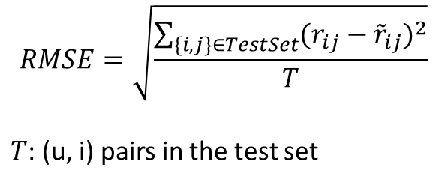
IV. EVALUATION
Evaluation
$$RMSE=\sqrt{\frac{\sum_{\{i,j\}∈TestSet}{{(r_{ij}−{\tilde{r}}_{ij})}^{2}}}{T}}$$
$T$: (u, i) pairs in the test set

Slide 17
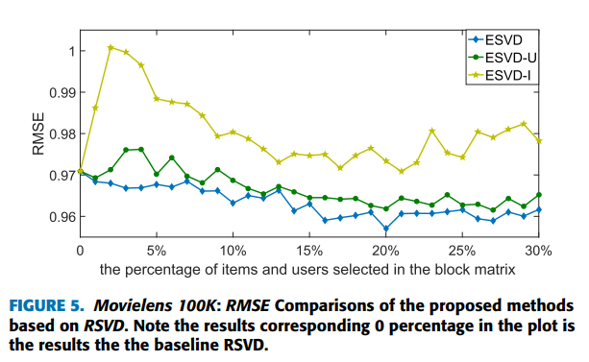
IV. EVALUATION

Slide 18
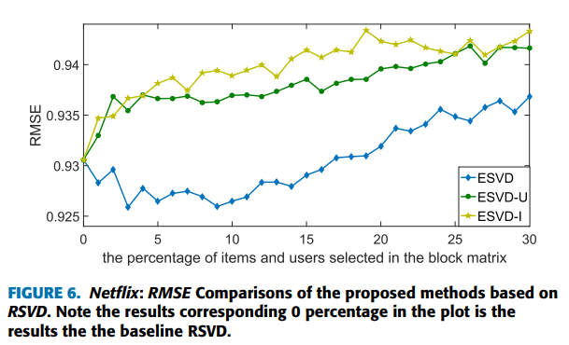
IV. EVALUATION

Slide 19
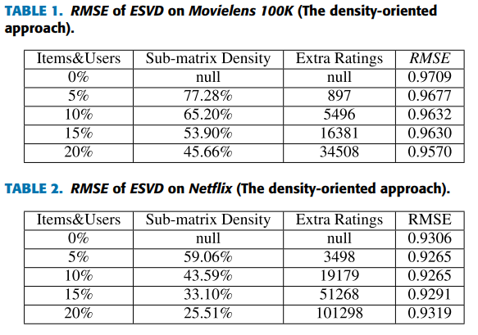
IV. EVALUATION
N = 3%,
RMSE = 0.9259

Slide 20
V. Multilayer ESVD(MESVD)
문제점
All extra ratings are predicted in a single matrix factorization model simultaneously, which could lead to significant bias and distort the original model when the number of pre-estimates is large

Slide 21
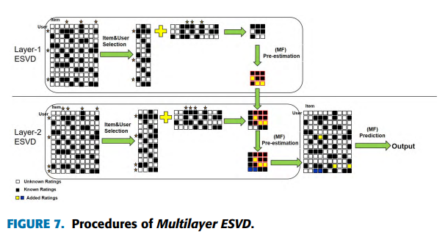
V. Multilayer ESVD(MESVD)
Two-layer ESVD

Slide 22
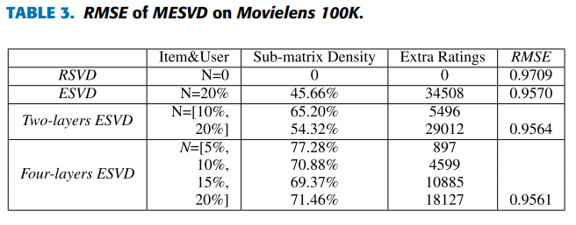
V. Multilayer ESVD(MESVD)

Slide 23
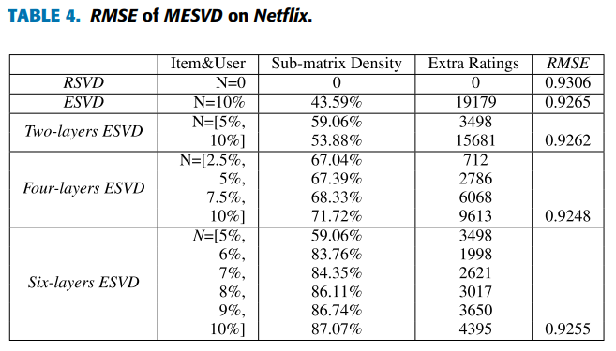
V. Multilayer ESVD(MESVD)

Slide 24
VI. Extensions of ESVD
To deal with the datasets with an imbalance between the number of users and the number of items
Item-wise ESVD(IESVD)
&
User-wise ESVD(UESVD)

Slide 25
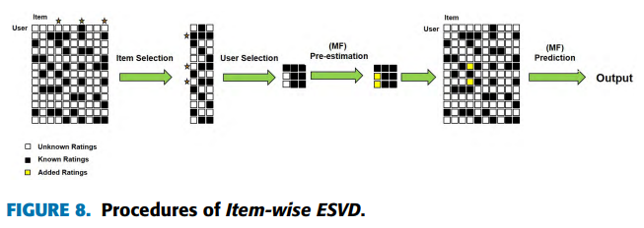
VI. Extensions of ESVD: IESVD
Item의 개수보다 user의 수가 더 많은 rating matrix를 다룰 때

Slide 26
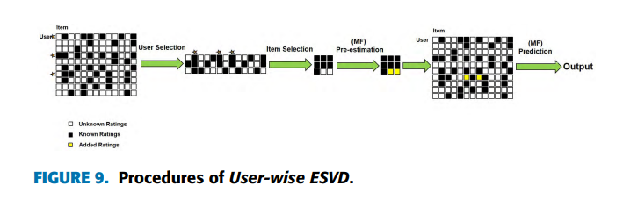
VI. Extensions of ESVD: UESVD
User의 수보다 item의 개수가 더 많은 rating matrix를 다룰 때

Slide 27
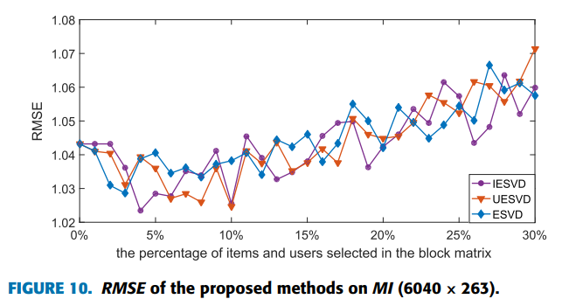
VI. Extensions of ESVD

Slide 28
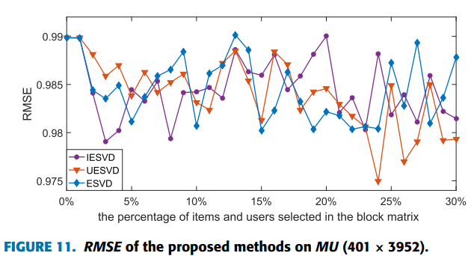
VI. Extensions of ESVD

Slide 29
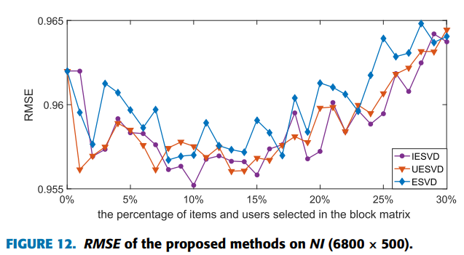
VI. Extensions of ESVD

Slide 30
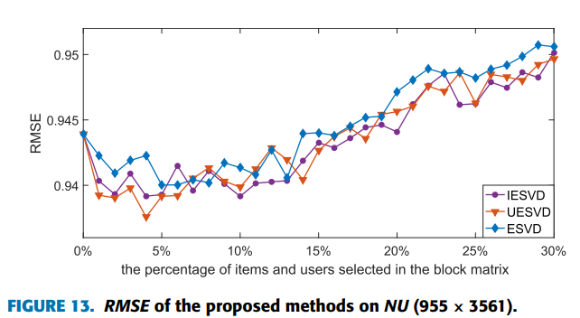
VI. Extensions of ESVD

Slide 31
Conclusion
일반적인 ESVD 모델은 MF 방식을 통해 결측치를 예측하는데 유용함.
MESVD 모델은 반복적으로 모델을 학습함으로써 더 나은 성능을 기대할 수 있으나 cost가 높음
IESVD, UESVD : Item-user 간 데이터 불균형을 해결하기 위해 제안된 모델로, 불균형 데이터에 대해서 EVSD보다 성능이 우수함.
2016 ppt by ⓒ 유비

